Slide 1
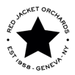
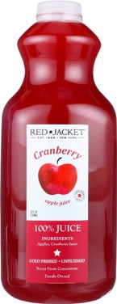
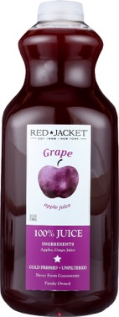
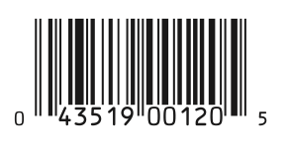
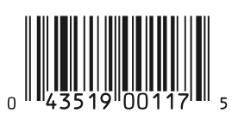
Category: Dairy (Refrigerated Juice)
Case Cost: (to be defined by Rainforest)
Unit Cost: (to be defined by Rainforest)
SRP: $5.99
Gross Margin: (to be defined by Rainforest)
Case Pack: 4 x 52oz
Promo Support Program:
16 weeks: 15% (minimum requirement)
Shelf Life: 30 days at production
100% cold pressed, all natural, unfiltered
No added sugar, water or preservatives
Produced in 100% LEED certified facility
Third generation orchard located in Finger Lakes region of NY, in business for over 60 years

